Slide 1


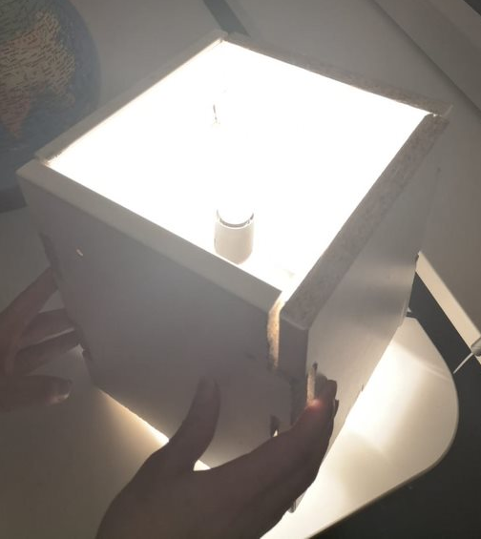




PRODUCT
The lamp
MATERIALS
Wooden planks
SOURCE
Houses
INHOLLAND CIRCULAR CHALLENGE
TEAM 3:
Timothy van der Steenhoven
Saskia van der Velden
Emmanuel Bakare
Production proces
ELEMENT Kitchen doors
Notes:
Introduction and production proces (Timo)
Questions at the end, if the presentator hasn’t said it before.
Introduction:
Introduce the members of our team (name (and study?))
First start with the challenge we have gotten from the Alliantie.
Production Proces:
Then explain that there are going to be a lot of usable materials available
from 1 home. Then suprise the audience by telling them the actual number:
60.000 homes to renovate.
So what if we can circulate materials back into the houses?
For example: our lamp.

Slide 2
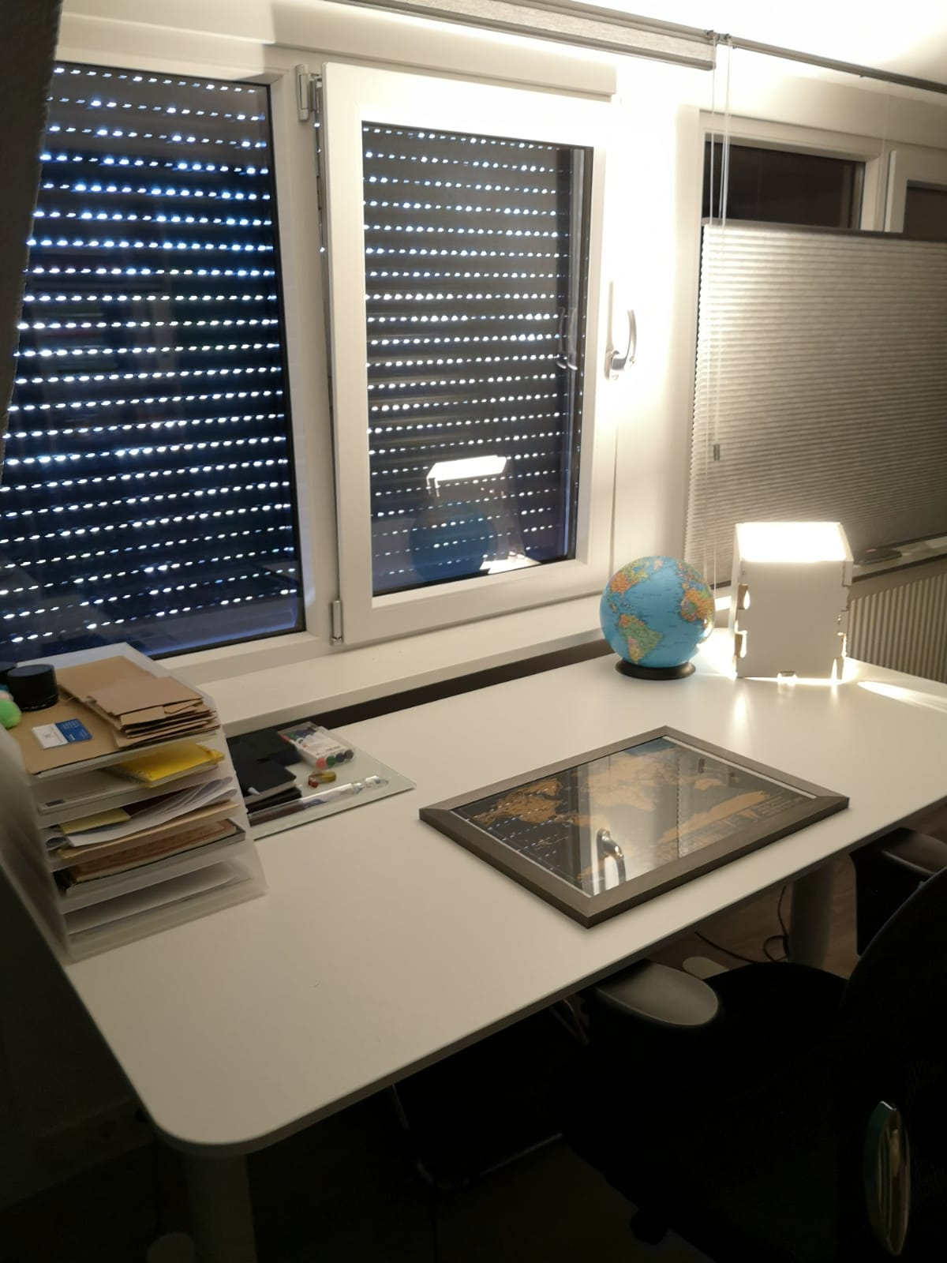

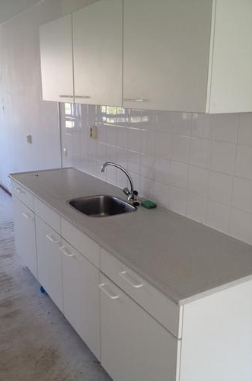

From problem to solution
Notes:
Emmanuel

Slide 3



Potential customers
And more if there is a company interested
Notes:
First: Emmanuel.
About selling the lamp as a circular product in stores.
Second: Timo
About working together with parties to provide the lamps
to residents of the homes of de Alliantie.
To explain:
exchange houses: houses where people live in between the renovations.

Slide 4
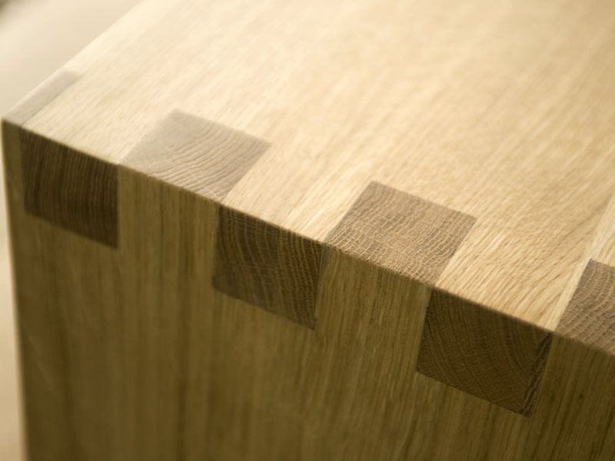
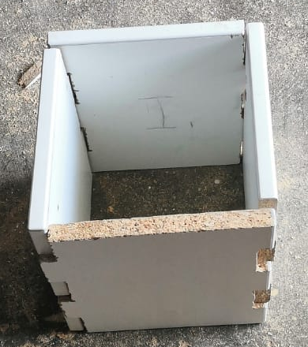
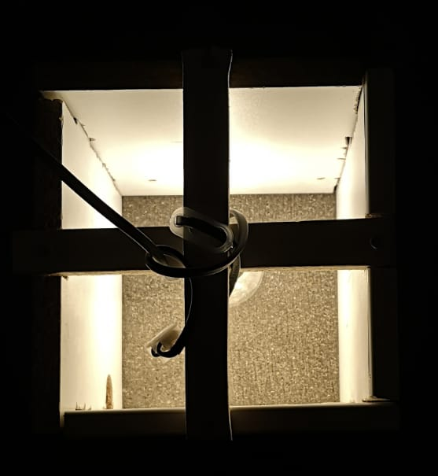
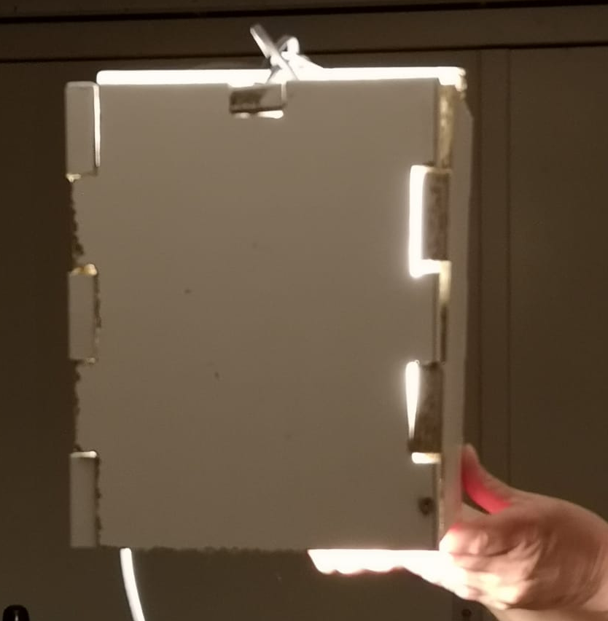
The design
Standing
OPTIONS
CONNECTION
Tandverbinding / boxjoint
Hanging
Notes:
Saskia
The design
The lamp is made out of a wooden board that used to be a kitchen door.
How is it made?
Out of the kitchen door we cut 4 exact same pieces that will fit in to eachother like puzzle pieces.
The connection between the puzzle pieces will be a boxjoint/tandverbinding.
Then we cut two more pieces to make a cross in the lamp, so it can stand, but also hang.
The boxjoint will be made without using glue so that the lamp is fully recyclable and reuseable.

Slide 5
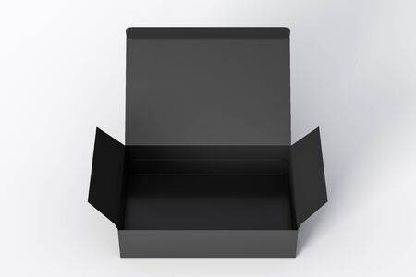

Further
THE END
THANK YOU FOR YOUR TIME
INHOLLAND CIRCULAR CHALLENGE
TEAM 3:
Timothy van der Steenhoven
Saskia van der Velden
Emmanuel Bakare
Notes:
Saskia
Further
We are using materials of the Alliantie and we would love to put them back in the houses.
To do this we are planned to start with a few lamps that we will put in the exchange houses.
If there are people that like them they can buy them for there own houses.
…….
This is the end of the pitch thank you for your time and if there are any quetions please don’t be afraid to ask them.

